Slide 1
Introduction to Deep Learning
Session11,12,13
Arunkarthik T

Slide 2
Agenda
A Single Neuron
Deep Neural Networks
Stochastic Gradient Descent
Overfitting and Underfitting similar to linear and logistic regression session
Dropout and Batch Normalization
Binary Classification
Courtesy: Kaggle.com

Slide 3
What is Deep Learning?
Deep learning is an approach to machine learning characterized by deep stacks of computations. This depth of computation is what has enabled deep learning models to disentangle the kinds of complex and hierarchical patterns found in the most challenging real-world datasets.
Through their power and scalability neural networks have become the defining model of deep learning. Neural networks are composed of neurons, where each neuron individually performs only a simple computation. The power of a neural network comes instead from the complexity of the connections these neurons can form.

Slide 4
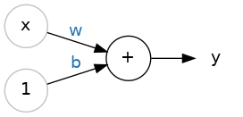
A Single Neuron: Learn about linear units, the building blocks of deep learning.
Let's begin with the fundamental component of a neural network: the individual neuron. As a diagram, a neuron (or unit) with one input looks like:
The input is x. Its connection to the neuron has a weight which is w. Whenever a value flows through a connection, you multiply the value by the connection's weight. For the input x, what reaches the neuron is w * x. A neural network "learns" by modifying its weights.
The b is a special kind of weight we call the bias. The bias doesn't have any input data associated with it; instead, we put a 1 in the diagram so that the value that reaches the neuron is just b (since 1 * b = b). The bias enables the neuron to modify the output independently of its inputs.
The Linear Unit: y=wx+b
The y is the value the neuron ultimately outputs. To get the output, the neuron sums up all the values it receives through its connections. This neuron's activation is y = w * x + b, or as a formula

Slide 5
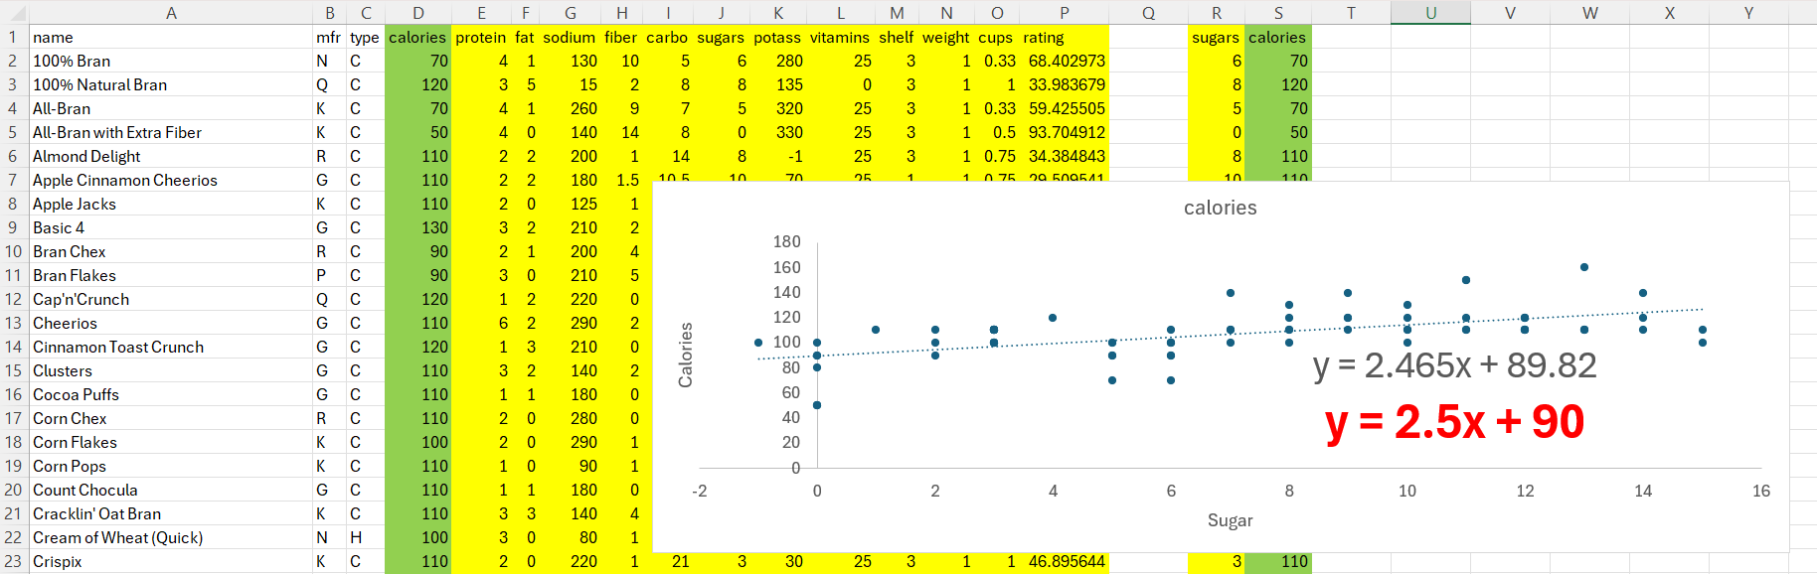
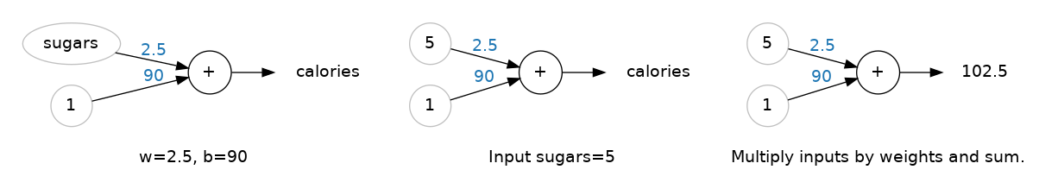
Example - The Linear Unit as a Model
Though individual neurons will usually only function as part of a larger network, it's often useful to start with a single neuron model as a baseline. Single neuron models are linear models.
Let's think about how this might work on a dataset like 80 Cereals. Training a model with 'sugars' (grams of sugars per serving) as input and 'calories' (calories per serving) as output, we might find the bias is b=90 and the weight is w=2.5. We could estimate the calorie content of a cereal with 5 grams of sugar per serving like this:

Slide 6
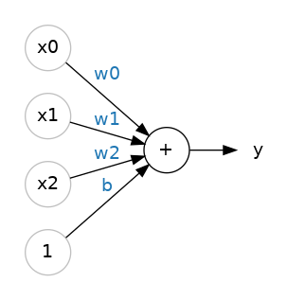
Multiple Inputs
The 80 Cereals dataset has many more features than just 'sugars'. What if we wanted to expand our model to include things like fiber or protein content? That's easy enough. We can just add more input connections to the neuron, one for each additional feature. To find the output, we would multiply each input to its connection weight and then add them all together.
A linear unit with three inputs.
The formula for this neuron would be y=w0x0+w1x1+w2x2+by=w0x0+w1x1+w2x2+b. A linear unit with two inputs will fit a plane, and a unit with more inputs than that will fit a hyperplane

Slide 7
Linear Units in Keras
The easiest way to create a model in Keras is through keras.Sequential, which creates a neural network as a stack of layers. We can create models like those above using a dense layer.
We could define a linear model accepting three input features ('sugars', 'fiber', and 'protein') and producing a single output ('calories') like so:
With the first argument, units, we define how many outputs we want. In this case we are just predicting 'calories', so we'll use units=1.
With the second argument, input_shape, we tell Keras the dimensions of the inputs. Setting input_shape=[3] ensures the model will accept three features as input ('sugars', 'fiber', and 'protein').
This model is now ready to be fit to training data!
from tensorflow import keras
from tensorflow.keras import layers
# Create a network with 1 linear unit
model = keras.Sequential([
layers.Dense(units=1, input_shape=[3])
])
Why is input_shape a Python list?
The data we'll use in this course will be tabular data, like in a Pandas dataframe. We'll have one input for each feature in the dataset. The features are arranged by column, so we'll always have input_shape=[num_columns]. The reason Keras uses a list here is to permit use of more complex datasets. Image data, for instance, might need three dimensions: [height, width, channels].

Slide 8
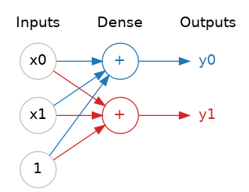
Deep Neural Networks: Add hidden layers to your network to uncover complex relationships.
Neural networks typically organize their neurons into layers. When we collect together linear units having a common set of inputs we get a dense layer.
Think of each layer in a neural network as performing some kind of relatively simple transformation. Through a deep stack of layers, a neural network can transform its inputs in more and more complex ways. In a well-trained neural network, each layer is a transformation getting us a little bit closer to a solution.
A dense layer of two linear units receiving two inputs and a bias.
Many Kinds of Layers A "layer" in Keras is a very general kind of thing. A layer can be, essentially, any kind of data transformation. Many layers, like the convolutional and recurrent layers, transform data through use of neurons and differ primarily in the pattern of connections they form. Others though are used for feature engineering or just simple arithmetic.

Slide 9
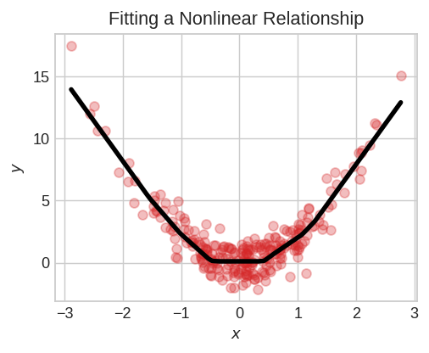
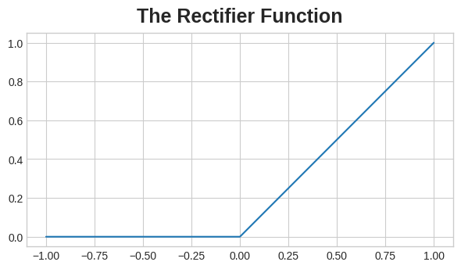
The Activation Function
Two dense layers are nothing in between are no better than a single dense layer by itself. Dense layers by themselves can never move us out of the world of lines and planes. What we need is something nonlinear. What we need are activation functions.
An activation function is simply some function we apply to each of a layer's outputs (its activations). The most common is the rectifier function max(0,x)max(0,x)
Without activation functions, neural networks can only learn linear relationships. In order to fit curves, we'll need to use activation functions.
The rectifier function has a graph that's a line with the negative part "rectified" to zero. Applying the function to the outputs of a neuron will put a bend in the data, moving us away from simple lines.

Slide 10
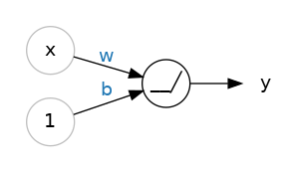
The Activation Function
When we attach the rectifier to a linear unit, we get a rectified linear unit or ReLU. (For this reason, it's common to call the rectifier function the "ReLU function".) Applying a ReLU activation to a linear unit means the output becomes max(0, w * x + b), which we might draw in a diagram like:
A rectified linear unit.

Slide 11
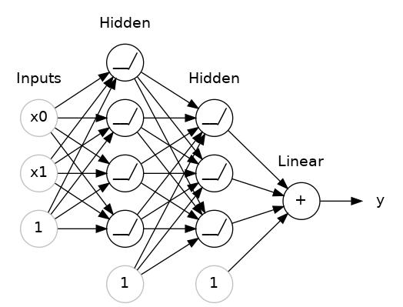
Stacking Dense Layers¶
let's see how we can stack layers to get complex data transformations.
The layers before the output layer are sometimes called hidden since we never see their outputs directly.
Now, notice that the final (output) layer is a linear unit (meaning, no activation function). That makes this network appropriate to a regression task, where we are trying to predict some arbitrary numeric value. Other tasks (like classification) might require an activation function on the output.
A stack of dense layers makes a "fully-connected" network.

Slide 12
Building Sequential Models
The Sequential model we've been using will connect together a list of layers in order from first to last: the first layer gets the input, the last layer produces the output. This creates the model in the figure:
from tensorflow import keras
from tensorflow.keras import layers
model = keras.Sequential([
# the hidden ReLU layers
layers.Dense(units=4, activation='relu', input_shape=[2]),
layers.Dense(units=3, activation='relu'),
# the linear output layer
layers.Dense(units=1),
])
A stack of dense layers makes a "fully-connected" network.

Slide 13
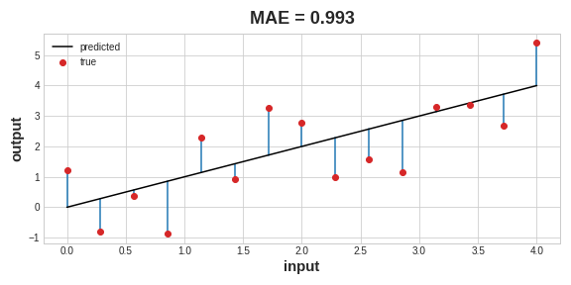
Stochastic Gradient Descent
In the 80 Cereals dataset, for instance, we want a network that can take each cereal's 'sugar', 'fiber', and 'protein' content and produce a prediction for that cereal's 'calories'. If we can successfully train a network to do that, its weights must represent in some way the relationship between those features and that target as expressed in the training data.
In addition to the training data, we need two more things:
A "loss function" that measures how good the network's predictions are.
An "optimizer" that can tell the network how to change its weights.
The mean absolute error is the average length between the fitted curve and the data points.
Training a neural network with Stochastic Gradient Descent.

Slide 14
Stochastic Gradient Descent
Each iteration's sample of training data is called a minibatch (or often just "batch"), while a complete round of the training data is called an epoch. The number of epochs you train for is how many times the network will see each training example.
The mean absolute error is the average length between the fitted curve and the data points.
Training a neural network with Stochastic Gradient Descent.

Slide 15
Learning Rate and Batch Size
Notice that the line only makes a small shift in the direction of each batch (instead of moving all the way). The size of these shifts is determined by the learning rate. A smaller learning rate means the network needs to see more minibatches before its weights converge to their best values.
The learning rate and the size of the minibatches are the two parameters that have the largest effect on how the SGD training proceeds. Their interaction is often subtle and the right choice for these parameters isn't always obvious. (We'll explore these effects in the exercise.)
Fortunately, for most work it won't be necessary to do an extensive hyperparameter search to get satisfactory results. Adam is an SGD algorithm that has an adaptive learning rate that makes it suitable for most problems without any parameter tuning (it is "self tuning", in a sense). Adam is a great general-purpose optimizer.
model.compile(
optimizer="adam",
loss="mae",
)
The gradient is a vector that tells us in what direction the weights need to go. More precisely, it tells us how to change the weights to make the loss change fastest. We call our process gradient descent because it uses the gradient to descend the loss curve towards a minimum. Stochastic means "determined by chance."

Slide 16
Dropout and Batch Normalization
There are two kinds of special layers, not containing any neurons themselves, but that add some functionality that can sometimes benefit a model in various ways. Both are commonly used in modern architectures.
The first of these is the "dropout layer", which can help correct overfitting.
We know overfitting is caused by the network learning spurious patterns in the training data. To recognize these spurious patterns a network will often rely on very a specific combinations of weight, a kind of "conspiracy" of weights. Being so specific, they tend to be fragile: remove one and the conspiracy falls apart.
This is the idea behind dropout. To break up these conspiracies, we randomly drop out some fraction of a layer's input units every step of training, making it much harder for the network to learn those spurious patterns in the training data. Instead, it has to search for broad, general patterns, whose weight patterns tend to be more robust.
keras.Sequential([
# ...
layers.Dropout(rate=0.5), # apply 50% dropout to the next layer
layers.Dense(16),
# ...
])
Here, 50% dropout has been added between the two hidden layers.

Slide 17
Batch Normalization
The next special layer we'll look at performs "batch normalization" (or "batchnorm"), which can help correct training that is slow or unstable.
With neural networks, it's generally a good idea to put all of your data on a common scale, perhaps with something like scikit-learn's StandardScaler or MinMaxScaler. The reason is that SGD will shift the network weights in proportion to how large an activation the data produces. Features that tend to produce activations of very different sizes can make for unstable training behavior.
Now, if it's good to normalize the data before it goes into the network, maybe also normalizing inside the network would be better! In fact, we have a special kind of layer that can do this, the batch normalization layer. A batch normalization layer looks at each batch as it comes in, first normalizing the batch with its own mean and standard deviation, and then also putting the data on a new scale with two trainable rescaling parameters. Batchnorm, in effect, performs a kind of coordinated rescaling of its inputs.
Most often, batchnorm is added as an aid to the optimization process (though it can sometimes also help prediction performance). Models with batchnorm tend to need fewer epochs to complete training. Moreover, batchnorm can also fix various problems that can cause the training to get "stuck". Consider adding batch normalization to your models, especially if you're having trouble during training.

Slide 18
Adding Batch Normalization
It seems that batch normalization can be used at almost any point in a network. You can put it after a layer...
layers.Dense(16, activation='relu'),
layers.BatchNormalization()
... or between a layer and its activation function:
layers.Dense(16),
layers.BatchNormalization(),
layers.Activation('relu')

Slide 19
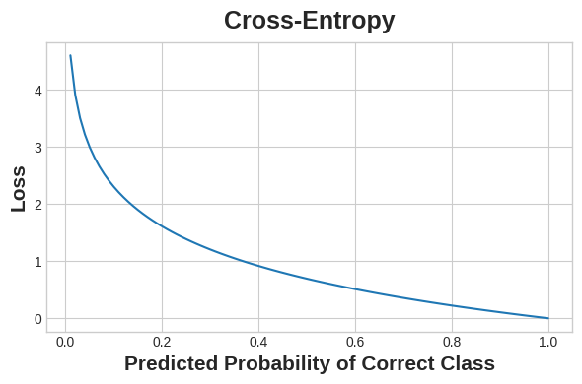
Binary Classification
So far, we've learned about how neural networks can solve regression problems. Now we're going to apply neural networks to another common machine learning problem: classification. Most everything we've learned up until now still applies. The main difference is in the loss function we use and in what kind of outputs we want the final layer to produce.
Classification into one of two classes is a common machine learning problem. You might want to predict whether or not a customer is likely to make a purchase, whether or not a credit card transaction was fraudulent, whether deep space signals show evidence of a new planet, or a medical test evidence of a disease. These are all binary classification problems.
In your raw data, the classes might be represented by strings like "Yes" and "No", or "Dog" and "Cat". Before using this data we'll assign a class label: one class will be 0 and the other will be 1. Assigning numeric labels puts the data in a form a neural network can use.
Accuracy and Cross-Entropy¶
Accuracy is one of the many metrics in use for measuring success on a classification problem. Accuracy is the ratio of correct predictions to total predictions: accuracy = number_correct / total. A model that always predicted correctly would have an accuracy score of 1.0. All else being equal, accuracy is a reasonable metric to use whenever the classes in the dataset occur with about the same frequency.
The idea is that we want our network to predict the correct class with probability 1.0. The further away the predicted probability is from 1.0, the greater will be the cross-entropy loss.

Slide 20
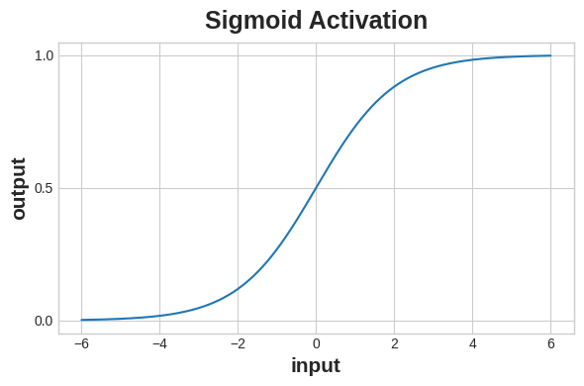
Making Probabilities with the Sigmoid Function
The cross-entropy and accuracy functions both require probabilities as inputs, meaning, numbers from 0 to 1. To covert the real-valued outputs produced by a dense layer into probabilities, we attach a new kind of activation function, the sigmoid activation.
To get the final class prediction, we define a threshold probability. Typically this will be 0.5, so that rounding will give us the correct class: below 0.5 means the class with label 0 and 0.5 or above means the class with label 1. A 0.5 threshold is what Keras uses by default with its accuracy metric.

